Slide 1


Competency -3 - Reading Skills
c. Identifying Tone, Themes & Ideas
Competency -3 - Reading Skills
c. Identifying Tone, Themes & Ideas
Department of English
Department of English
Module 1
Session -
Session 4 :
Punctuation for clarity: comma, semicolon, colon, apostrophe and the meaning they carry; punctuation that changes meaning.
Topic:

Slide 2
AIM OF THE SESSION
To develop students' ability to use punctuation marks correctly in written communication, improving clarity, meaning, and readability.
INSTRUCTIONAL OBJECTIVES
Identify common punctuation marks (full stop, comma, question mark, exclamation mark, apostrophe, quotation marks, colon, and semicolon).
Explain the purpose of each punctuation mark.
Use punctuation marks correctly in sentences.
Edit and punctuate short passages accurately.
LEARNING OUTCOMES
Identify punctuation marks correctly.
Explain their functions.
Apply punctuation accurately in sentences and short paragraphs.
Demonstrate understanding of how punctuation affects the meaning of writing.

Slide 3
Register and Clarity Rewrite Studio (Activity)
Identify the Register in the following sentences
Hey bro, I haven't finished the CAD drawing yet. Asking sir for extra time?
The CAD report deadline is Friday at 4:00 PM. An extension was requested.
Dear Sir, I am writing to respectfully request a short extension for the CAD report.
Now, write the following sentences to three different people: Friend, Colleague and Principal.
Ask whether tomorrow is a working day/holiday
Requesting guidance for applying for bank loan.
Let’s Recap

Slide 4
Answer
Sentence | Register | Reason
1. Hey bro, I haven't finished the CAD drawing yet. Asking sir for extra time? | Informal Register | Uses casual language ("Hey bro"), contractions, and conversational style suitable for friends.
2. The CAD report deadline is Friday at 4:00 PM. An extension was requested. | Neutral/Formal Register | Objective and impersonal. Appropriate for workplace communication or notices.
3. Dear Sir, I am writing to respectfully request a short extension for the CAD report. | Formal Register | Polite, respectful, and appropriate for communicating with a teacher or authority.

Slide 5
Answer
Situation | Friend (Informal Register) | Colleague (Neutral Register) | Principal (Formal Register)
Ask whether tomorrow is a working day or a holiday. | Hey! Is tomorrow a working day or a holiday? | Hi, could you please let me know if tomorrow is a working day or a holiday? | Good morning, Sir/Madam. Could you please confirm whether tomorrow is a working day or a holiday?
Request guidance for applying for a bank loan. | Hey, do you know how to apply for a bank loan? Can you guide me? | Hi, could you guide me on the procedure for applying for a bank loan? | Respected Sir/Madam, I would be grateful if you could guide me on the procedure for applying for a bank loan.

Slide 6
Some tips to write with clarity and appropriate register
Identify your audience first.
Adjust your tone according to the role.
Use precise, specific language.
Prefer active voice always.
Cut unnecessary words completely.
Replace jargon with clarity.
Eliminate all ambiguity.
Keep one message per sentence.
Improve readability through structure.
Match words to tone.

Slide 7
Read the following paragraph
attention everyone switch off the main power supply wear your safety gloves do not touch the exposed wires if you notice sparks inform the lab instructor immediately if not continue the experiment carefully remember safety comes first
Now, answer the following questions
Was the paragraph easy or difficult to read? Why?
Where would you pause while reading?
Which part confused you the most?
How would you revise the passage to make it clear and easy to understand?

Slide 8
Revised Paragraph
Attention, everyone! Switch off the main power supply. Wear your safety gloves. Do not touch the exposed wires. If you notice sparks, inform the lab instructor immediately. If not, continue the experiment carefully. Remember, safety comes first!
Think About It
Imagine you are working in an engineering laboratory. Which version of the instructions would you trust and follow? Why?

Slide 9
Punctuation Marks in Effective Communication
Punctuation marks are symbols used in writing to improve clarity, readability, indicate pauses and emphasis and idea. Incorrect punctuation can change the meaning of a sentence and create confusion in communication. Proper punctuation helps to convey the writer's intended meaning.
Example: Professor said the student is intelligent.
Professor said, “the student is intelligent.”
Let’s eat teachers (suggests eating teachers)
Let’s eat, teachers (invites teachers to eat)
Example: I like cooking my friends and YouTube.
I like cooking, my friends, and YouTube.
I like cooking, my friends, and YouTube

Slide 10
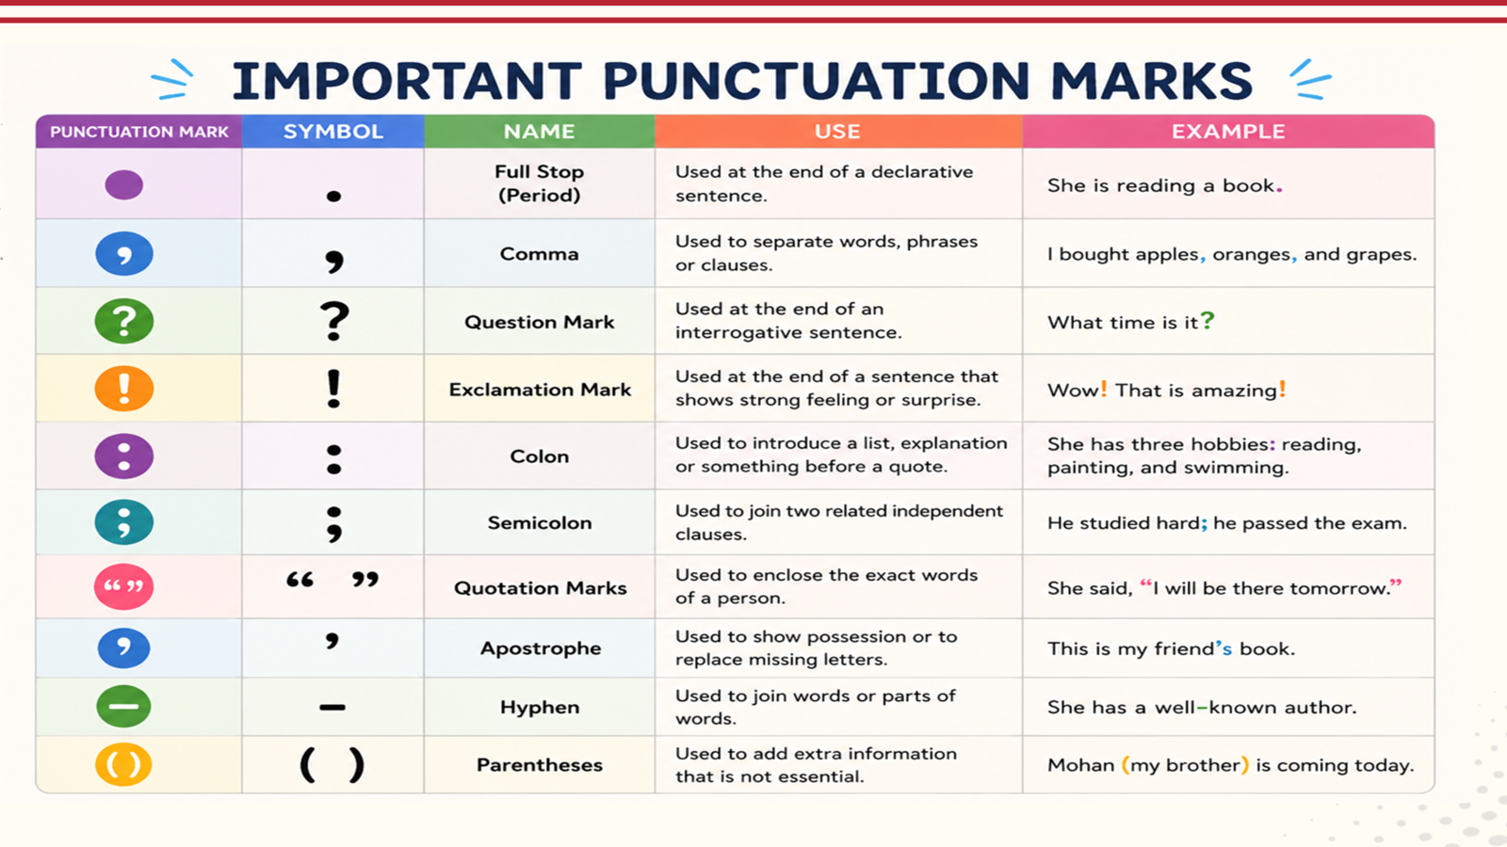

Slide 11
Uses of Comma ( , ) & Semicolon( ; )
Commas are used to separates clauses, ideas, or items in a list to help the reader pause and prevent sentences from becoming jumbled.
Joining clauses : She wanted to go for a walk, but it started raining.
Introductory phrase : After the long meeting, we decided to take a break.
Separate Items : I bought apples, bananas, and oranges.
Extra Information : Instagram, which is a famous social networking site, kills time.
Semicolon helps link two closely related, complete sentences without using a conjunction (like and or but).
Linking thoughts: My phone battery is drained; so I couldn't call a ride.
Replacing a conjunction: The weather was terrible; nevertheless, we went hiking.
Complex list: We visited Paris, France; Rome, Italy; and Athens, Greece.
I like cooking, my friends, and YouTube

Slide 12
Uses of & Colon ( : ) & Apostrophe ( ’ )
Colon introduces a list, an explanation, an example, or a quote after a complete statement.
Introducing a list: Please bring three things: a pen, a notebook, and an open mind.
Introducing an explanation: There was only one problem: we were completely lost.
Direct quote: The speaker began with a simple statement: "Success takes practice.“
Time: Separate hours and minutes. 7:10 am 12:30 pm
An apostrophe is a punctuation mark used for showing possession, forming contractions, and indicating plurals of letters or numbers.
Singular Possession: Add 's (Sarah's book).
Plural Possession: Add ' if it ends in s (dogs' toys); add 's if it doesn't (children's room).
Contractions: Put an apostrophe where missing letters were dropped (don't, it's).
Missing Digits: Put an apostrophe before shortened years ('90s).
I like cooking, my friends, and YouTube

Slide 13
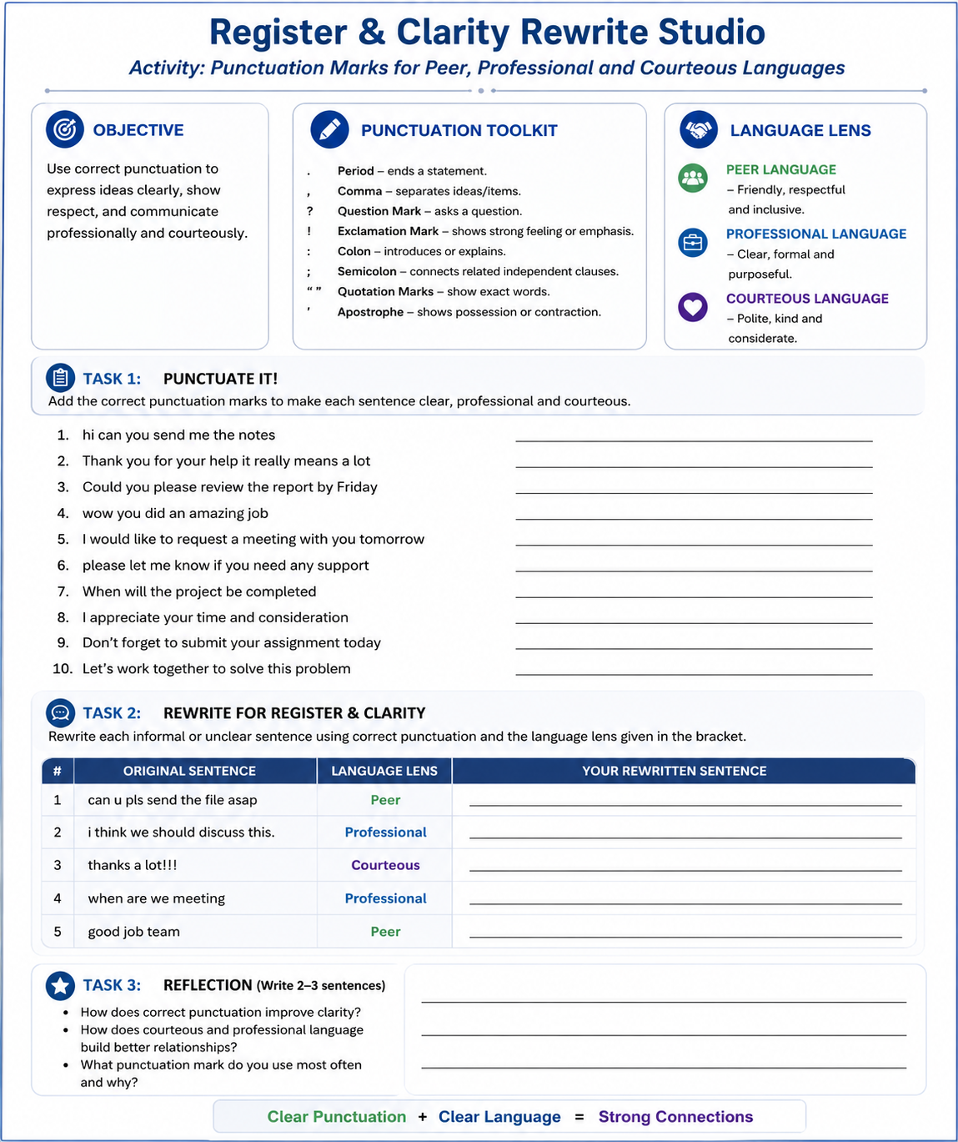

Slide 14
Rewrite the following sentences with clarity
the assignment was submitted by the student before the bell rang for the campus placement drive at kl university
because the Kl campus is very big students get lost looking for the seminar hall which is confusing
passing the semester exams requires hard work by everyone and proper notes must be maintained by you
after eating at the canteen the laptop was left on the bench by the computer science student
the bus to kanuru was completely packed so he missed the mid exam because it was late
inside the engineering lab the main switchboard was repaired by the technician who was wearing safety gloves

Slide 15
Check these sentences
The student submitted the assignment before the KL University campus placement drive bell rang.
Because the KL University campus is vast, students easily get confused and lose their way to the seminar hall.
To pass the semester exams, you must work hard and maintain proper notes.
After eating at the canteen, the computer science student left the laptop on the bench.
Because the Kanuru bus was late and packed, the student missed the midterm exam.
Wearing safety gloves, the technician repaired the main switchboard inside the engineering lab.

Slide 16
Activity
Write a paragraph of five sentences without punctuation marks and give prompt to correct it by using AI tools.
Use Editing Tools: AI-powered options like: Quill Bot Punctuation Checker or the Grammarly Sentence Rewriter to instantly restructure text and eliminate errors.

Slide 17
Let’s Watch
https://www.youtube.com/watch?v=gfYq2ng9s4E

Slide 18
Activity
Create a graphical representation by using AI tools on Punctuation Marks.

Slide 19
Summary
Makes writing clear and meaningful.
Prevents misunderstanding.
Improves readability and organization.
Helps express emotions and tone.
Ensures grammatical correctness.
Punctuation marks are essential tools in written communication. Proper use of punctuation helps readers understand the writer's message accurately and makes writing more effective and professional.

Slide 20
SELF-ASSESSMENT QUESTIONS
1.Can I identify different punctuation marks in a sentence?
2.Can I explain the purpose of a full stop, comma, question mark, and exclamation mark?
3.Can I use punctuation marks correctly when writing sentences?
4. What problems can arise from incorrect punctuation?

Slide 21
Terminal Questions
1.What is punctuation?
2.Name four common punctuation marks and state their uses.
3.Why is punctuation important in written communication?
4.How can a comma change the meaning of a sentence?

Slide 22
REFERENCES FOR FURTHER LEARNING OF THE SESSION
e-References:
https://www.twinkl.co.in/teaching-wiki/punctuation
https://tvtropes.org/pmwiki/pmwiki.php/Main/PunctuationChangesTheMeaning
Video links:
https://www.youtube.com/watch?v=gfYq2ng9s4E

Slide 23
THANK YOU
Team – Language Skills for Engineers

